Slide 1
Performance and Progress 2012/2013

Slide 2
Why We Do an Annual Data Presentation
To assess the Levy’s performance in various categories against goals.
To highlight grantees’ accountability in reporting who they are serving, how much service program participants receive, and whether outcomes are achieved.
To improve both program delivery and administration over time.

Slide 3
Report Topics and Outline
Overall Levy performance gauged by:
Number and demographic characteristics of children served
Request for Investment policy goals
Program participation levels
Service Outcomes
Staff turnover rates
Notes:
All data is from the 2012/2013 fiscal year.

Slide 4
Children Served
Numbers of Children Served
Demographics of children served as proxy for how investments reach children more likely to experience negative outcomes:
Age
Socioeconomic Status
Primary Language in the home
Race/Ethnicity
Notes:
Presentation covers data collected from grantees to look at program accountability and performance.
Demographic variables included in presentation are important because children’s demographic characteristics are strong predictors of their likelihood of experiencing positive or negative outcomes. We examine the following demographic variables in this presentation because a growing body of research indicates that these are key factors correlated with children’s outcomes:
Age. The growth and development of children is critical to their later health and life success. In particular, providing supports early in a child’s life, including prevention-based services, can increase the likelihood that children grow to their full potential.
Socioeconomic Status. Family income and associated wealth often predict children’s access to and experience with opportunities that can support their growth, development and education. Poverty is highly predictive of children lacking the educational and developmental resources they need to thrive, learn and succeed.
Primary Language in the Home: Children from families in which English is not the primary language in the home have greater likelihood of facing challenges with accessing and understanding the mainstream education, health and social service systems, compared to their English speaking counterparts. Those systems are challenged to make their services available in multiple languages and with cultural responsiveness. This barrier can impede families use of supports available to them.
Race/Ethnicity. Race/Ethnicity is highly correlated with children’s outcomes in school and in their overall wellbeing and safety. Compared to white children in Oregon, children of color are more likely to experience an academic achievement gap, disproportionate exclusionary discipline, and over-representation in the child welfare system.
Taken together, looking at these variables helps us understand whether and how Levy investments are reaching children most likely in need of support.

Slide 5
Number of Children Served FY 12-13
Goal: 9,267 children
Actual: 12,088 children
Programs served 30.4% more children than projected.
 | FY 09-10 | FY 10-11 | FY11-12 | FY12-13
Goal | 14,611 | 15,726 | 14,885 | 9,267
Actual | 15,541 | 17,557 | 17,809 | 12,088
# +/- | 930 | 1,831 | 2,924 | 2,821
% +/- | 6.4% | 11.6% | 20.5% | 30.4%
Notes:
Key Point: Levy programs served fewer children in FY 12-13 than in past years due to decreased Levy revenues and funding reductions for Levy grantees. Levy programs exceeded service targets in FY12-13 due mainly to the large numbers of children served in a few programs that offer drop-in and less intensive service models where reaching as many children as possible is the goal and projecting precisely how many will be served each year is challenging.
Additional Information/Analysis
Serving more children than projected can be a positive or a negative. It might mean that a program is experiencing high turnover where children enter the program, stay for a short time, leave and are replaced by other children.
Other reasons for exceeding the projected number of children served include garnering additional funding from other sources, forming partnerships with other organizations that allow more children to be served, targets that were set too conservatively and/or or an increase in demand that programs are able to meet with existing staff.

Slide 6
Directing Service to East Portland
Extra points in application process given to programs that planned to serve East of 82nd Ave.
PCL tracks the number served by the zip code of residence or school.
38.6% of children served resided or went to school in zip codes East of 82nd Ave.
25% of Portland residents live in East Portland.
Notes:
Key Point: The Levy is meeting its policy goal of providing a significant portion of services to East Portland residents in recognition of the fact that East Portland has a higher rate of poverty, particularly a higher child poverty rate, as compared to the rest of Portland.
Additional Information/Analysis
The percentage of people at or below the federal poverty rate is 19.1% for East Portland, and 16.1% for Portland as a whole; the poverty rate for children residing in East Portland and East Multnomah County is even higher, typically ranging between 30% - 40% according to census data analyzed by Greater Portland Pulse.
25% of Portland residents live in East Portland as defined by the East Portland Action Plan Committee and including the zip codes located East of 82nd Ave. (147,347/583,776; 2010 Census Data).
Data for past four years has been consistent: 37% - 39% of children served either lived or attended schools in zip codes East of 82nd Ave.
The zip codes that are within the boundaries of the City of Portland and include areas East of 82nd Ave. are as follows: 97216, 97220, 97230, 97233, 97236, and 97266. Some of these zip codes also include areas that lie outside the boundaries of the City of Portland.
42.8% of children served lived in SE Portland, 23.7% in NE Portland, 15.3% in North Portland, 5.1% in NW and SW Portland, 1.6% of children served were homeless, and 11.5% did not indicate their geographic residence.

Slide 7
Culturally Specific Programs
Extra points in application process given to culturally specific programs/organization.
Indicator | Culturally Specific Programs | Mainstream Programs
% of children of served | FY 09/10: 12.5% FY 10/11: 15.9% FY 11/12: 15.3% FY12/13: 12.9% | 87.5% 84.1% 84.7% 87.1%
% of annual investment | FY10 – FY12: 31% FY12-13: 30% | 69% 70%
Notes:
Key Point: Culturally specific programs/organization have typically served 13% - 16% of children served annually and received approximately 30% of Levy revenues.
Additional Information/Analysis
Fluctuations in numbers served and funding are related to the overall changes in the Levy’s grant portfolio over the past 4 years. Leverage Fund grants were given and ended during this period, and Levy revenues declined leading to reductions in program funding for all Levy grantees.

Slide 8
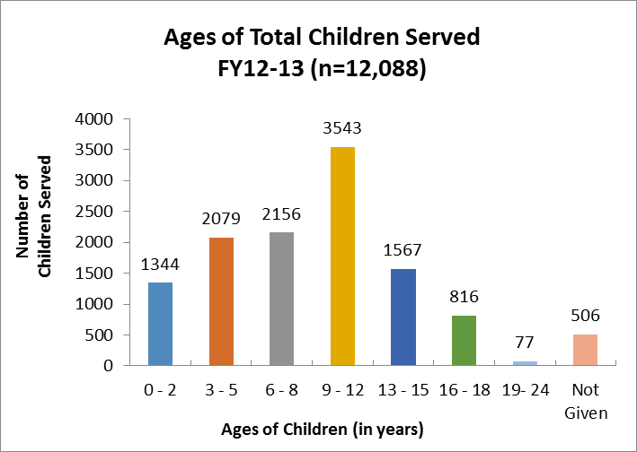
Age Groups
Notes:
Key Point: Levy programs are more heavily weighted toward serving children aged 0-5, and this trend has been true for the past several years. This trend indicates Levy investments are reaching children early on when prevention and intervention is most likely to be effective.
Additional Information/Analysis
Age range of 0-5 (early childhood) is 24% of the age spectrum of 0-24 represented on the graph above. However, the number of children aged 0-5 served is 30% of the total number served. Of the total children served, 48% are ages 0 – 8 years.
This distribution indicates that a significant portion of children served by levy investments are young children and programs are reaching them during the crucial period of early development.
As has been the trend for the past three years, the proportion of children ages 0 – 5 served by Levy foster care investments (35%) is nearly the same as in the foster care population (38.6%). Serving the same proportion of children is important, but if the Levy wants to better support this vulnerable group and help mitigate the effects of entering the foster care system at such a young age, we may want to focus future foster care investments more directly for this population.
Over the past four years children ages 0-5 have composed 42% to 53% of children served by child abuse prevention investments, surpassing the number of young children represented in the foster care population (34.2% to 38.6%).

Slide 9
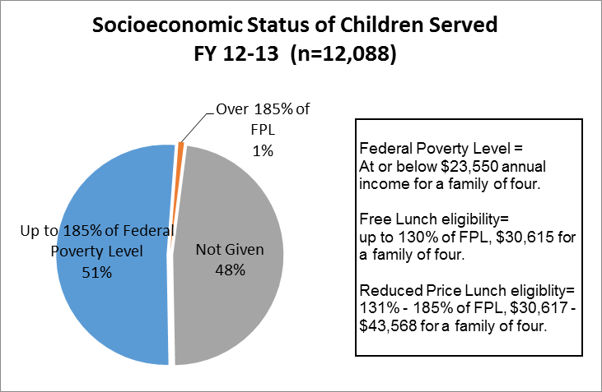
Socioeconomic Status
Notes:
Key Point: Data shows that services are indeed reaching children in poverty, which has been consistent for all years. Levy investments continue to reach children most likely in need of additional supports.
Additional Information/Analysis
Income data are collected differently by Early Childhood (EC) and Child Abuse Prevention & Intervention (CA) grantees than by After School and Mentoring (ASM) grantees. EC/CA grantees collect income data directly from clients; ASM grantees receive Free & Reduced Lunch qualification data from school districts about groups of children served.
Altogether, 51% of children served are living in households with incomes that range from the federal poverty level (FPL) and up through 185% of FPL. The FPL for the relevant year was $23,550 for a family of 4; 185% of FPL was $43,568 for a family of 4.
As a point of reference, 56.1% of the students enrolled in the schools districts serving the City of Portland (PPS, Reynolds, Parkrose, David Douglas, Centennial) were eligible for a free or reduced price lunch in 2012/2013. 83.5% of the youth served in Levy funded after-school and mentoring programs were eligible to receive a free or reduced price lunch. As noted below, not all PCL programs gather family income data so we lack this data point on 48% of the children/families served with PCL programs.
As a point of reference, the median income for a family of 4 in Portland is $68,300 (Portland Housing Bureau, 2013). This means the majority of children served in our programs come from families whose annual income is, at best, around half of the median income.
Over the past several years, the percent of children served who come from families with annual incomes at 185% of FPL or less has varied between 51% to 60% of children served.
Over the past several years, the Levy typically has not received SES data for over 40% of children served each year. These data are not given due to the ways in which programs collect client data and provide services. In addition, we only have federal lunch program participation data on a portion of the youth who participate in after-school and mentoring programs. However, we know that nearly 80% of the schools served by grantees had rates of participation in the federal lunch program of 60% of the enrolled students so it is likely that the funded after-school programs are reaching significantly more students in poverty than is reflected in these data.

Slide 10
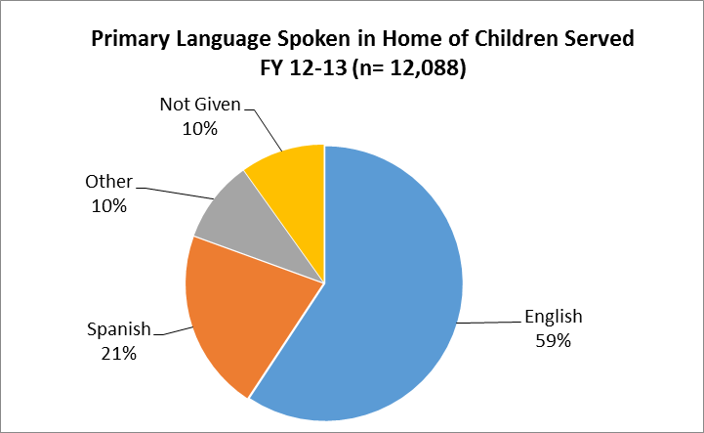
Primary Language
Notes:
Key Point: The Levy is reaching a significant percentage of children from homes where the primary language spoken is not English, which is a strong predictor of children’s later challenges with academic achievement. The number (and proportion) of children served by the Levy, who speak a primary language other than English or Spanish, has grown substantially over the past 6 years.
Additional Information/Analysis
31% of children come from homes were the primary language spoken is not English.
Across all program areas, over 1000 children served come from homes where the primary language is neither English nor Spanish.
From data grantees reported at least 47 other languages, plus American Sign Language are spoken, including: Amharic, Arabic, Bisaya/Visayan, Bosnian, Burmese, Chin, Chinese, Chuukese, Creole, Croatian, Dinka, Eritrean, Ethiopian, Farsi, French, German, Gujarati, Hindi, Hmong, Ibibio, Japanese, Karen, Kirundi, Korean, Lao, Maay Maay, Mayan, Micronesian, Mien, Mixteco, Moldovan, Nepali, Oromo, Rohingya, Romanian, Russian, Slovak, Somali, Swahili, Tagalog/Filipino, Tigrinya, Tibetan, Tongan, Turkish, Ukrainian, Vietnamese, Yapese.
Over the past 6 years, the proportion of children speaking a primary language other than English or Spanish, has grown from 7% in FY 06-07 to between 10% - 11% for the past few years.

Slide 11
Race/Ethnicity Data: Context
Present data to look at who PCL programs serve through an equity lens.
Analyze whether we are reaching populations that are more likely to experience a significant achievement gap as compared to the white middle-income population.
Analyze whether PCL is addressing the significant overrepresentation of Native American and African American children in the foster care system.
Analyze whether PCL is investing equitably across program areas and in each program area.

Slide 12
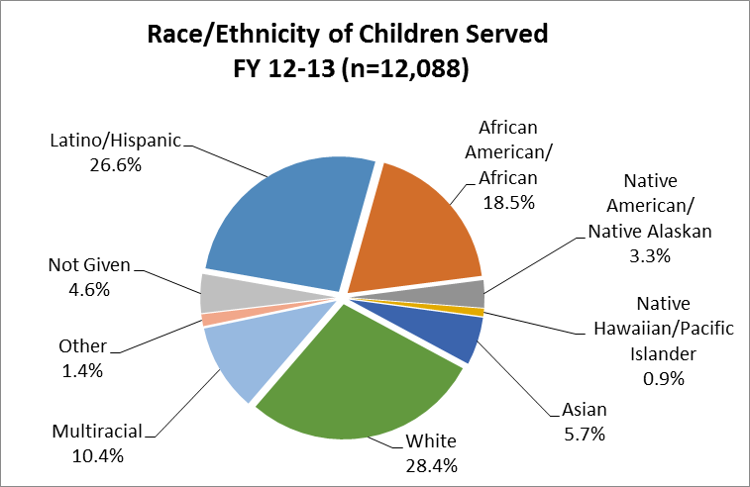
Race/Ethnicity
Notes:
Key Point: The majority of children served are children of color (63%).
Additional Information/Analysis
Latino children are the largest population among children of color served (26.6%) followed by African American children (18.5%). This has been the trend over the past several years.

Slide 13
Race/Ethnicity Data FY12-13
Population | % of Levy Program Participants Served | % 2012/2013 Enrollment in Portland School Districts | % Multnomah County Population
Children of Color | 66.9% | 48.8% | 27.9% (all ages)
White Children | 28.4% | 51.2% | 72.1% (all ages)
Compared to white children, children of color are more likely to experience:
Lower rates of meeting/exceeding academic achievement benchmarks
Disproportionately higher rates of exclusionary discipline in schools
Over-representation in child welfare system
Notes:
Key Points:
The Levy is serving children of color at least proportional to school enrollment and population proportions.
More importantly, the Levy has successfully reached proportionally more children who are more likely to experience the education achievement gap, disproportionate exclusionary discipline in schools, and overrepresentation in the foster care system.
Additional Information/Analysis
Data reported this year are similar to data from the previous 3 years.
For this analysis, Portland school districts include PPS, David Douglas, Centennial, Reynolds, and Parkrose. The Reynolds and Centennial districts include schools that are NOT in the City of Portland, and serve students who do not reside in the COP. Source of school enrollment data for this slide and the next 4 slides is the Oregon Department of Education.
Demographic categories for Oregon Dept. of Education data are slightly different than the categories PCL uses. For example, PCL figures include African-American and African immigrant together in the African-American category. ODE uses “Black” as the category which would also likely include African-American and African immigrant children.
Data on Multnomah County population for these slides is from the 2010 US Census.
Analysis by the Coalition of Communities of Color, as reported in Communities of Color in Multnomah County: An Unsettling Profile, indicates that the population of communities of color in Multnomah County and Portland is likely larger than Census data reflects due to a variety of historical factors and data collection challenges. While the Levy appears to be serving a significantly greater proportion of children of color as compared to either the percentage of children of color enrolled in Portland school districts, or the percentage of all people of color living in County, we cannot be completely confident in these findings due to challenge of likely undercounts by school and census data.
Across all race/ethnicity categories for children of color, trends in American Community Survey data as analyzed by the Coalition of Communities of Color indicate that children are a higher percentage of minority populations and that Portland will become more diverse over time due to higher birth rates among women of color compared to white women.
For additional local data on the academic achievement gap, disproportional exclusionary discipline and over-representation in the foster care system, go to the reports at the following links:
http://allhandsraised.org/wp-content/uploads/2012/10/BPI-Report-Rev.pdf
http://www.oregon.gov/Hispanic/pdfs/final_hispanic_gap_report_9-1-09_1.pdf
http://allhandsraised.org/wp-content/uploads/2012/10/exclusionary_discipline_1-3-12.pdf
http://web.multco.us/sites/default/files/ccfc/documents/final_quantitative_report.pdf
Various reports from the Coalition of Communities of Color: http://www.coalitioncommunitiescolor.org/research/research.html

Slide 14
Race/Ethnicity Data FY12-13
Population | % of Levy Program Participants Served n=12,088 | % 2012/2013 Enrollment in Portland School Districts n=76,083
Latino Children | 26.6% | 21.2%
African-American Children | 18.5% | 9.8%
Asian/Pacific Islander Children | 6.6% | 10.6%
Native American/ Alaskan Native Children | 3.3% | 1.0%*
Multiracial/ethnic Children | 10.4% | 6.2%
White Children | 28.4% | 51.2%
Not Given | 4.6% | 0%
Notes:
Key Point: Data on PCL service to the populations listed above is more difficult to interpret for the reasons set forth below.
Additional Information/Analysis
PCL does not currently fund any grants that are solely focused on funding programs for the API population which is the likely reason that we are serving fewer API youth as compared to the percentage of the school they make up. PCL does fund multiple grants to culturally specific providers that focus on Latino, African American and Native youth which likely accounts in part for higher levels of service penetration for those populations.
*As noted in the previous slide, there are many issues with underestimating the demographic population data for communities of color. For example, as noted in the Communities of Color in Multnomah County: An Unsettling Profile report, the Native American/Alaska Native population may comprise up to 5% of the local population and school enrollment using “community-validated” method for quantifying the local Native population at large (this includes individuals who identify solely as Native or who identify as Native and with other racial/ethnic heritage).
According to the census data reported in “Making the Invisible Visible” report on the Native American community in Portland, there are twice as many multiracial Native Americans as there are Native Americans of one race living in the Portland metropolitan area. Thus it is possible that a significant number of multiethnic children served by PCL are of Native American descent.
The fact that there was no race/ethnicity data on nearly 5% of children served by PCL programs also assures that some or all of the categories of race/ethnicity served are underreported.
It is unclear why the school district data indicates no children’s race/ethnicity data was “not given”.

Slide 15
Race/Ethnicity Data: Issues in Levy Programming
Population | % of Levy Foster Care Participants Served n=523 | % of Levy Child Abuse Participants Served n=2,569 | % children in Foster Care Multnomah County n=2,356
African American/ African | 27.5% | 18.0% | 22.1%
Asian/Pacific Is. | 1.3% | 2.1% | 2.7%
Native American | 20.1% | 3.2% | 7.0%
Latino/ Hispanic | 7.1% | 25.7% | 15.0%
Multiracial | 10.7% | 13.9% | n/a
White | 32.5% | 32.6% | 52.6%
Not Given | 0% | 3.3% | 0.5%
Notes:
Key Point: Levy foster care programming has successfully been directed toward Native American and African American populations that are over-represented in the foster care system.
Additional Information/Analysis
Foster Care:
No significant changes in the data from the previous year.
Contracts with culturally specific foster care service providers assure the Levy reaches the Native American and African American populations.
Levy foster care programs are serving a smaller percentage of Latino/Hispanic children as compared to the percentage of Latino/Hispanic children in the foster care population. The percentage of Latino/Hispanic children in foster care in Multnomah County increased from 11.3% in FY09-10 to 15.0% in FY12-13. In the future, PCL may want to focus investment in services for this population.
Child Abuse:
The percentage of Latino children served continues to increase (from 16.9% in FY 10-11 to 25.7% in FY 12-13).
In order to have an impact on the overrepresentation of African American and Native American children in foster care, PCL may need to prioritize investments that serve these populations.
Data Details
Source of Multnomah County Data, DHS Child Welfare; unduplicated children in foster care in Multnomah County July 1, 2012 through June 30, 2013.
Race/Ethnicity Data: Issues in Levy Programming

Slide 16
Race/Ethnicity Data: Issues in Levy Programming
At the macro level, the Levy has successfully directed proportionally more programming to populations likely to experience disproportionately poor outcomes.
Some Levy program areas have service gaps.
In Child Abuse Prevention & Intervention, proportionally fewer African American children and Native American children are served. In Mentoring, proportionally fewer Latino children, Asian children and Native American children are served. In Foster Care, proportionally fewer Latino children are served.

Slide 17
What is Missing from Race/Ethnicity Data
Data on sub-populations of “white” (Eastern European immigrants), and “black” (African immigrants).
Duplicated race/ethnicity data that reflects all of the multiple races/ethnicities with which each program participant identifies
The ability to disaggregate outcome data by other variables (poverty, race/ethnicity)
Notes:
Levy demographic forms do not currently require that grantees record service to Eastern European immigrants separate from “White/European-American” participants. The form allows grantees to report these separately if they choose, but because it is not required, we do not have uniform data across all grantees. Similarly, the form does not currently require that African immigrants be counted separately from African-Americans, although some grantees choose to do so. In addition, other governments and institutions do not necessarily separate these two immigrant groups from the overall “White” and “Black” categories which means that even if the Levy did collect the data, there may not be any comparison population level data for comparison purposes. On the other hand, failing to separate out these data may mask whether we are reaching sub-populations within larger categories that may have different levels and types of risks than other populations reported in the category. With the current data collected, the language data variable is the best proxy for understanding how well we might be reaching immigrant groups generally.
Federal census data and American Community Survey data on race and ethnicity are broken down in a variety of ways that provides a much richer picture of which multiple races and ethnicities people identify as and in what combinations. Multnomah County is planning to move to a system that also tracks the multiple races and ethnicities of its program participants. Levy staff are considering adding this to our reporting requirements to provide a better picture of the multiple races and ethnicities with which program participants identify instead of only reporting the category as “Multiracial.”
Many large institutions such as school districts and the Oregon Department of Education have databases that track individuals demographic characteristics along with educational data. This allows these institutions to further break down data to understand, for example, how many African-American 3rd graders are meeting the reading benchmark as compared to the number of white 3rd graders meeting the benchmark. Because the Levy does not have a central database of client level data (thus does not require grantees to report data on individuals into a central database), we are unable to disaggregate outcome data by demographic groups to understand whether program outcomes vary by race/ethnicity or other variables. While this information could be useful, getting it would require significant financial investment in a database, training for staff and grantees to use the database, and increased reporting burden for grantees. At this juncture, given the current financial picture, Levy staff are not contemplating moving in this direction.

Slide 18
Participation Data
Fourth year the Levy has collected this data
Data are relevant to program “dosage”
Dosage is important in affecting outcomes for children
Uses of the information:
Raising awareness and improving participation rates at the program level.
Establishing expectations for participation levels in program areas and among similar programs.
Long term goal: using information to more effectively focus services.
Notes:
Key Point: We are seeking to establish reasonable participation expectations in program areas and, where possible, for similar types of programs so that we can assess whether funded programs are meeting a relevant standard.

Slide 19
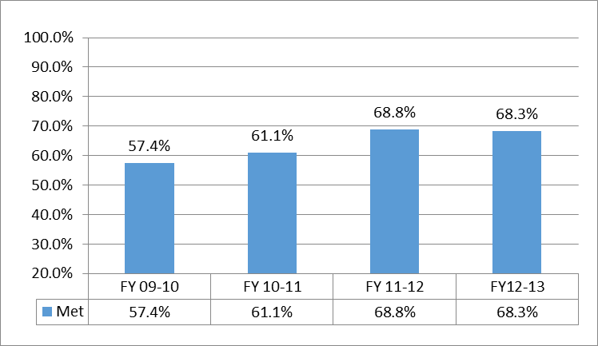
Participation Data
Percent of children, parents or families
that met participation thresholds each year
Notes:
Key Point: These data were baseline in FY09-10. Comparing the three years shows that on average, over 60% of program participants met participation thresholds and the rate has increased over time.
Additional Information/Analysis
Thresholds are based on the minimum level of participation that a grantee believes is necessary (based on experience, data, and/or research) in order to produce the program’s intended outcomes with participants.
Examples of participation thresholds: 1) attending 30 days of SUN programming during the school year; 2) attending mentoring sessions at least 4 hours per month for 6 months; or 3) enrolled at least six months in programs that last at least one school-year or calendar year.
In cases where different participation thresholds were set for tracking various outcomes specified in a contract, staff used data on participation in the main service component(s) for the purpose of aggregating these participation data.

Slide 20
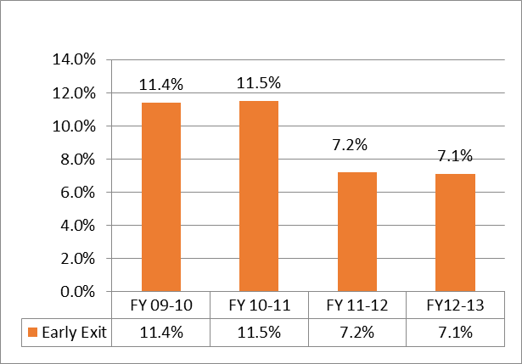
Participation Data: Early Exits
Percentage of participants that exit relatively quickly
after enrollment
Notes:
Key Point: The vast majority of participants served by Levy programs are not exiting programs before we would expect them to derive any benefit from the program. Early exits are often due to circumstances outside the participants’ or the programs’ control.
Additional Information/Analysis
Although the aggregate early exit rate has remained stable for the past 4 years, there is greater variation between program areas.
FY 12/13 early exit rates by program area are as follows:
Early Childhood: 3.2%
Child Abuse: 11.6%
Foster Care: 1.6%
After-School: 8.2%
Mentoring: 4.6%
Early exit rates for the Foster Care program area were much lower than the other program areas. For this program area, early exit is defined as exiting the program within 90 days of enrollment.
Early exit data was collected on all programs for which it is a relevant measure. These data were not collected for programs designed as one-time services or programs that, by design, don’t exit participants early. Some programs’ data were excluded from FY 12/13 data because Levy funding reductions resulted in those programs having to exit participants prematurely.

Slide 21
Outcome Data
Outcome Goal Areas: Early Childhood, Child Abuse and Foster Care
Child development
Child health
Child early literacy
Parenting/family functioning
Child stability and welfare
School Success
Outcome Goal Areas: After-School and Mentoring
School attendance
School behavior
Academic achievement
Self Confidence
Positive Social Behaviors
Connection to School
Homework Completion
Notes:
These are the outcomes included in this report.

Slide 22
Outcome Data: Limitations
The data we are reporting are descriptive, not causative.
Many data points provide information on progress made while children are enrolled.
Percentages reported apply only to those programs tracking the outcome, the clients who met a participation threshold and who were assessed.
Notes:
Key Point: The data reported in the outcomes section are subject to important limitations.
Additional Information/Analysis
Descriptive not Causal Data:
Our data are descriptive about what happened with children in our programs during the time in which they were served, and, in some cases, that data are compared with the same data on the same children for the prior year. Our data neither show that our programs caused these results nor do they say that our programs did not cause these results. Our data mainly help us understand what happened with children served by our grantees.
Outcomes specific to Programs that Measure them:
Our data are based on only the programs that collected and reported data for outcomes relevant to their program models. Not all programs collected data on each outcome.
Percentages in the following slides are not based on all 12,088 children served. The number of children for whom the percentage applies is listed with each outcome statement. In all cases, the percentages listed only apply to the children who met the participation threshold set by the grantee and who were assessed.

Slide 23
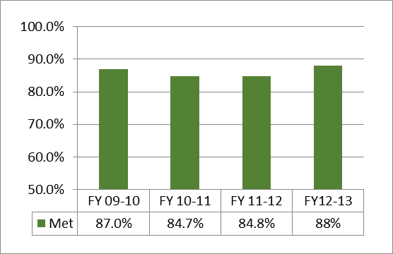
Grantee Outcome Goals
Percent of outcome goals met by grantees each year
Notes:
Key Point: The percentage of outcome goals met by grantees has been at least 85% for the past 4 years.
Issues with Outcomes Goals
Appropriate Measurement Tools and Targets:
Sometimes the outcome goal the grantee selects turns out to be too difficult to measure or not appropriate for the service delivered. In addition, data gathered sometimes turns out not to be a good measure of the outcome goal.
Goals are sometimes set without reliable data on past performance to inform the decision on what the target should be.
More rigorous measures of goals sometimes result in grantees meeting fewer of their goals. Conversely, lack of rigorous measurement tools sometimes results in ALL program participants meeting the goals.
Technical Assistance for Outcome Measurement:
PCL provided technical assistance to grantees to assist in the following tasks:
Assuring outcome goals chosen for measurement are most appropriate for service delivered and targets chosen are reasonable;
Assessing appropriateness of measurement tools used to assess outcomes and recommending replacement when necessary;
Assisting grantees in designing methods to record and analyze data gathered;
Providing or arranging for grantee staff training where necessary;
Ongoing monitoring of data collection and analysis after changes made.
Missing Data:
Foster Care program data were too limited to report in FY 09-10 due to the majority of participants enrolling in programs later in the service year and not yet participating long enough to meet the threshold for measuring outcomes.

Slide 24
Early Childhood: Child Development
88% of children were meeting key age appropriate developmental milestones in gross motor, fine motor, cognitive, communication, and social emotional skills.
99% of those not meeting milestones in one or more developmental domain were referred and/or provided additional services.
Communication is the domain with the highest number of children identified as at risk for delay/disability and in need of additional assessment/services.
Notes:
Key Point: Children appear to be on track with age-appropriate developmental expectations, and data from the past several years show a general trend of 85% - 90% of children on track with developmental milestones and 10% - 15% not on track.
Additional Information/Analysis
Trends:
Other past trends: over 90% of children not on track were provided and/+or referred for additional services; and communication is the domain that has had the highest number of children identified as in need of additional assessment/services.
National Prevalence comparison:
CDC data indicate approximately 17% of children nationally have a developmental delay or disability. Our programs’ data mirror this rate, but are slightly better. Levy grantees’ data suggest that the rate of disability/delay detected in the screenings are just above national prevalence rates. These data may suggest that programs are helping catch risks/delays early, which are what Levy-funded early childhood programs seek to accomplish by doing periodic developmental screening and monitoring of child development.
Reasons for Monitoring Development:
Screening children to gauge whether they are on track with age-appropriate developmental milestones is an important part of identifying and intervening in any developmental issues before children reach school. Early identification and intervention can help children work on specific skills before they reach kindergarten, making smoother transitions to school for children, parents, and schools.
Data Details:
Data reported are based on 10 grantees and 536 children that completed at least 6 months of services and 2 screenings. 470/536= 88% on track with developmental milestones.

Slide 25
Early Childhood: Other Outcomes
Health:
98% of children were screened for health and wellness needs.
85% of children screened for immunizations were up to date.
Parenting:
At least 82% of parents met parenting knowledge or skills goals.
Notes:
Key Point: Indicators of kindergarten readiness include early literacy development, physical health and wellness, and positive parent-child relationships. Data from grantees indicate children are meeting other outcomes that contribute to kindergarten readiness.
Additional Information/Analysis
Health: Health screenings monitor children’s physical wellbeing, which directly affects the ability to learn. The screenings typically monitor: height, weight, vision, hearing, and immediate medical needs. Some also check dental health and nutrition. In addition, immunizations are required for public school enrollment, so assuring children complete them is a key element of school readiness and of public health in school communities.
98% (416/426) children screened for health needs. 31 children with identified health needs were referred to additional services (9 grantees).
85% (269/317) children up to date with immunizations (7 grantees).
Parenting: Research indicates early childhood programs can help increase parents’ understanding of child development, and engage in more activities that support positive child development and behavior.
87% (52/60) of parents demonstrated or increased knowledge of child development (2 grantees).
94% (83/88) of parents demonstrated appropriate parent-child interactions (4 grantees).
82% (62/76) of parents demonstrated or increased knowledge of ways to manage child behavior (2 grantees).
96% (250/260) of parents demonstrated or increased positive parenting practices (4 grantees).
Over 400 parents participated in parenting classes or home visiting services. For parenting classes, parents attended 50% or more of sessions, which typically lasted up to 12 weeks. For home visiting services, parents completed at least 6 months of service. (9 grantees)

Slide 26
Child Abuse Prevention/Intervention: Child Development
64% of children were on track in the development of social/emotional skills.
82% of children screened met developmental milestones (excludes social emotional domain).
99% of children identified to have developmental concerns received and/or were referred to additional services.
Notes:
Key Point: Research has shown that promoting children’s social and emotional development mitigates the effects of various abuse and neglect risk factors. The majority of program participants were on track for this developmental outcome.
Additional Information/Analysis
National prevalence rates of developmental delay among children are around 17%, according to the Center for Disease Control. Given that children at risk of abuse and neglect are a high risk population living in stressful environments, it is not surprising that the percentage of children identified to have developmental concerns, especially as they relate to social emotional development, is higher than the national rates.
Developmental screenings are meant to catch developmental issues early, and based on our data, it appears our programs are helping catch risks/delays early and connect families with additional services.
Data Details
Data reported by 5 grantees and are based on 261 children that completed at least 6 months of services and at least 2 screenings. 150/233 = 64% on track with social-emotional milestones; 213/261 = 82% on track with developmental milestones (excluding social-emotional). 105/106 = 99% of children identified to have developmental concerns received and/or were referred to additional services.

Slide 27
Child Abuse Prevention/Intervention: Other Outcomes
94% of families did not have any substantiated child abuse allegations within 6 months of completing services.
Over 80% of participants met parenting and family functioning goals.
Notes:
Key Point: Other indicators of child safety and well-being include absence of substantiated child abuse reports, positive parenting and family functioning and improved mental health for children and youth. The majority of participants are meeting these outcomes.
Additional Information/Analysis
Child Maltreatment is rarely measured because of the difficulty of identifying substantiated cases of abuse and neglect. However, one program that receives most of its referrals from the Child Abuse Hotline has the ability to collect those data.
82% (16/17) of families did not have any substantiated child abuse allegations within 6 months of completing services (1 grantee).
Parenting & Family Functioning outcomes are important indicators of child safety and well-being.
82% (133/163) of parents increased social supports (5 grantees).
86% (206/239) of parents demonstrated appropriate or improved parent-child interactions (6 grantees).
90% (82/91) of parents increased their knowledge of the effect of domestic violence or sex abuse on children (4 grantees).
91% (102/112) of parents increased knowledge of child development and/or ways to manage child behavior (4 grantees).
Approximately 400 families participated in parenting classes or home visiting services and met the participation threshold for outcome measurement. For most home visiting services, outcomes are reported for families that completed at least six months of services. For parenting classes, outcomes are typically reported for participants that attended at least 50% of the parenting sessions, which usually lasted 10-12 weeks (10 grantees).

Slide 28
Foster Care: Child & Family Outcomes
91% of birth parents met parenting goals.
97% of reunified families did not have any substantiated child abuse allegations within 6 months of reunification.
85% of children accessed needed health and wellness services within 6 months of referral.
At least 87% of youth improved on school success related outcomes.
Notes:
Key Point: The majority of participants are meeting the outcomes established by grantees that serve birth parents working on reunification; focus on child health; or address school success.
Additional Information/Analysis
Parenting outcomes are an important indicator of child safety and well-being for families that have been reunified or are working toward reunification.
91% (30/33) of birth parents met parenting goals (2 grantees).
Child Maltreatment is measured as an outcome for the foster care programs that provide services to birth families that reunify after enrolling in the program. These data are obtained directly from DHS child welfare.
97% (38/39) of reunified families did not have any substantiated child abuse allegations within 6 months of reunification (3 grantees).
Child Health studies show that children in foster care have a higher prevalence of physical, developmental, dental, and behavioral health conditions than any other group of children. Research also indicates that many lack adequate or appropriate health care while in foster care.
85% (44/52) of children with identified health and wellness needs were referred to and accessed services within 6 months of referral (1 grantee).
School Success is an important indicator of overall success of children in foster care. Research suggests that children in foster care tend to be less engaged in school and have lower school achievement and educational attainment than do other children.
100% (33/33) of youth improved their attitude/connection/engagement to school/learning (1 grantee).
89% (58/65) of youth improved school stability (2 grantees).
87% (41/47) of youth improved school behavior (1 grantee).
88% (53/60) of youth improved academic achievement (1 grantee).

Slide 29
After-School and Mentoring: School Attendance and Behavior Outcomes
82% of program participants attended school at least 90% of school days.
78% of program participants with behavior referrals for suspension or expulsion in 11/12 had no such referrals in 12/13.
Notes:
Key Point: After-school and mentoring program participants show good school attendance considering the risk level served (78% eligible for free or reduced priced lunch program), and three quarters of the youth with serious referrals avoided behavior referrals while participating in Levy funded programs.
Additional Information
Research on chronic absenteeism suggests that students attending fewer than 90% of school days are at elevated academic risk, and some recent research suggests students need to attend 95% of school days to achieve academically.
The percentages of program participants attending 90% of school days and reducing serious behavior referrals have been stable for the past three years.
Data Details
Attendance outcome: 3297/4019 = 82%; 22 programs reporting.
Behavior Outcome: 223/285 = 78%; 22 programs reporting.

Slide 30
After-School and Mentoring: Academic Achievement Percentage of students meeting state standards in reading and math
Subject | PCL Participants | Combined Districts %
Reading/Lit | 47.2% | 67.4%
Math | 54.8% | 60.6%
Notes:
Key Point: Participants in Levy after-school and mentoring programs lag in meeting reading and math benchmarks as compared to the districts as a whole.
Additional Information/Analysis
Likely reason for differing levels of achievement is that most PCL programs are targeting low income, minority students with academic challenges.
Combined districts refers to the aggregate achievement data for the 5 school districts with schools in the City of Portland (PPS, David Douglas, Parkrose, Centennial and Reynolds). Centennial and Reynolds data includes students who do not reside in the City of Portland.
The score required to meet state benchmarks in reading was raised substantially between the 10/11 school year and the 11/12 school year which has resulted in significantly fewer youth meeting those benchmarks in all school districts in the city as compared with earlier years.
Data Details
Meet/Exceed Reading Standards: 1432/2615 = 54.8%; 22 programs reporting.
Meet/Exceed Math Standards: 1242/2631 = 47.2%; 22 programs reporting.
Additional Achievement Data
32.2% of program participants who did not meet reading benchmarks in 11/12 moved to a higher performance category in 12/13.
30.3% of program participants who did not meet benchmarks in math in 11/12 moved to a higher performance category in 12/13.
Performance categories were as follows: very low, low, nearly meets, meets, exceeds.
Data Details
Reading Outcome: 311/966 = 32.2%; 22 programs reporting.
Math Outcome: 361/1191 = 30.3%; 22 programs reporting.

Slide 31
After-School and Mentoring: Other Outcomes
83% of participants maintained high or increased self-confidence.
76% of participants maintained or increased positive social behaviors.
90% of participants maintained or improved their attitude toward or connection to school.
68% of participants demonstrated regular or improved homework completion.
Notes:
Key Point: Program participants demonstrated positive outcomes in key areas linked to school and life success.
Data Details
Self confidence: 1329/1600 = 83%; 9 programs reporting.
Increased positive social behaviors: 1019/1344 = 76%; 8 programs reporting.
Improved attitude toward or connection to school: 562/627 = 90%; 10 programs reporting.
Regular or improved homework completion: 612/895 = 68%; 6 programs reporting, all of which were after-school programs.

Slide 32
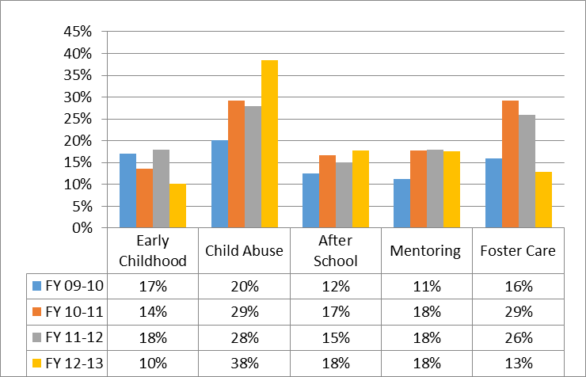
Staff Turnover
Percentage of Levy-funded positions
that turned-over each year
Notes:
Key Point: Across all program areas Levy-wide, 19% of staff positions paid by Levy funds turned over during FY12-13. Staff turnover among Levy-funded positions has ranged between 10% - 38% over the last four years depending on the program area.
Additional Information/Analysis
Child Abuse Prevention/Intervention programs have had the highest staff turnover rates for each of the past four years.
Staff turnover impacts the quantity and quality of services. Programs that experience staff turnover are often unable to meet service goals due to staff vacancies and lower level of service while new staff are oriented and trained. For relationship-based services (e.g. home visiting) turnover in direct service staff positions impacts participation levels and continued engagement of program participants. Additionally, PCL administrative time increases when staff turnover occurs at the program manager level.

